Slide 1

Vulnerabilities in C/C++ codes
Anish Jangir

Slide 2
Types of vulnerabilities in C/C++ codes
Buffer Overflow
Integer Overflow and underflow
Format string vulnerabilities
Command line problems
Pointer vulnerabilities

Slide 3
Buffer Overflow
Buffer overflows are caused by not having built-in boundary check features in C++, which reduce the risk of overwriting memory. Writing outside our allocated memory can cause program crashes and corrupt data. It can even lead to the execution of malicious code. Example code snippet:
#include <stdio.h>
#include <string.h>
int main(void){
char buffer[10];
printf("What is your name: ");
scanf("%s", buffer);
printf("You are in, %s!\n", buffer);
return 0;
}

Slide 4
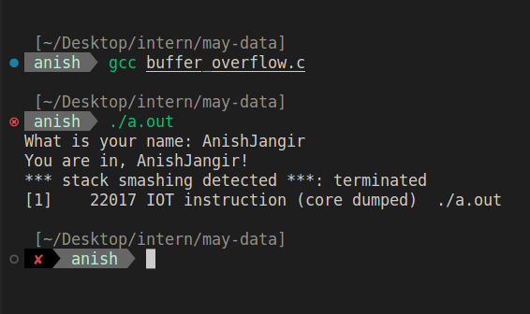
Output for above program:
If input length is greater than specified

Slide 5
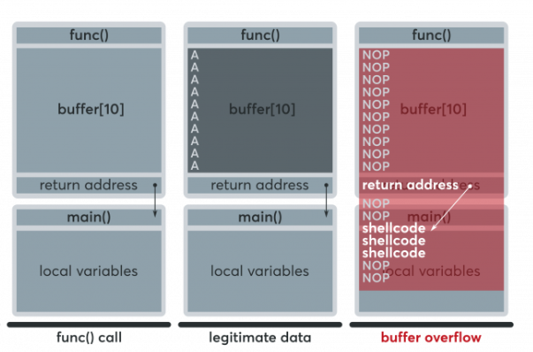
What happens during the buffer overflow

Slide 6
Possible solution for this problem:
Stack canaries add a new, randomly selected secret value to the stack every time a program starts. Before a function returns, this value is verified.
ASLR(address space layout randomization) prevents an attacker from knowing the memory layout, making it challenging to perform the buffer overflow attack. If the attacker doesn’t know where the data resides in memory, they won’t know which buffer to attack.
DEP(data execution prevention) marks certain memory areas, like the stack, as non-executable memory.

Slide 7
Heap Spraying attack
The heap is a region of memory used for dynamic memory allocation, and it is a common target for attackers due to its flexibility and predictability. In a heap spray attack, an attacker will allocate a large number of objects containing malicious payloads, usually in the form of shellcode or other executable code. The attacker will then attempt to force the heap allocator to place these objects in specific locations in memory.

Slide 8
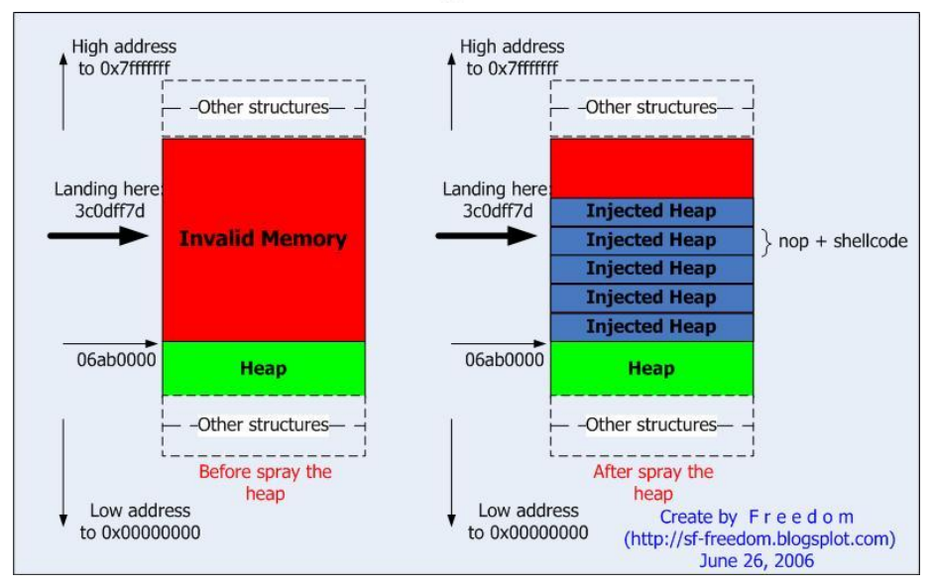
Heap spraying

Slide 9
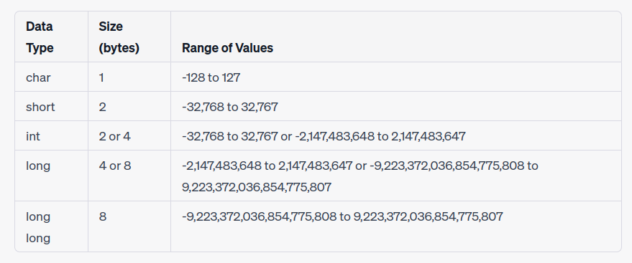
Integer Overflow
Integer overflow, also known as wraparound, occurs when an arithmetic operation outputs a numeric value that falls outside allocated memory space or overflows the range of the given value of the integer.

Slide 10
Example code:
#include <stdio.h>
#include <limits.h>
int main() {
int x = INT_MAX;
printf("x = %d\n", x);
x = x + 1;
printf("x = %d\n", x);
return 0;
}
Output of above program is :
x = 2147483647
x = -2147483648

Slide 11
#include <stdio.h>
#include <stdlib.h>
int main() {
int num_items = 100000;
int item_price = 50000;
int total_sales = num_items * item_price;
int cogs = 700000;
int profit = total_sales - cogs;
printf("Profit: $%d\n", profit);
return 0;
}
Here , after multiplying 100000 and 50000 integer overflows and hence answer will be incorrect.
To get correct answer long long can be used in place of int,

Slide 12
Format String Vulnerabilities
A format string vulnerability is a type of software vulnerability that occurs in C/C++ programming languages when a program takes input from an untrusted source (such as user input) and uses it as a format string argument for a formatted printing function like printf() or sprintf() without proper validation.
When a program uses a format string that includes format specifiers (such as %s, %d, %x) to output data, it expects the corresponding arguments to be passed in a specific format.
However, if an attacker can control the input passed as a format string argument, they can manipulate the behavior of the program by inserting their own format specifiers or modifying the values of existing ones.

Slide 13
Example:
#include<stdio.h>
#include<string.h>
Void fun(char *str){
printf(“%s”,str);
}
Int main(){
Char buffer[100];
gets(buffer);
fun(buffer);
Return 0;
}
The argument passed in fun() is directly given to printf().
If the string given by user contains a format specifier like “%s”, the printf() will interpret it as format specifier and look for an additional argument which is not there. This can lead to undefined behaviour or even crash.
gets() function takes input from user without checking its length,which can cause buffer overflow

Slide 14
Common string vulnerabilities
Unbounded string copies
Null termination errors
Truncation
Written outside array bound
Off-by one errors
Improper data sanitization

Slide 15
Example- Strcpy(),Strcmp(),Strcat(),gets()
#include <stdio.h>
int main()
{
char s1[10];
char s2[12];
printf("enter the string\n");
scanf("%s", s2);
strcpy(s1, s2); // strcpy does perform bounds checking
printf("s1 is %s\n", s1);
return 0;
}

Slide 16
#include <stdio.h>
#include <string.h>
int main(){
char buffer[10];
char *password = "password";
printf("Enter your password: ");
scanf("%s", buffer);
if (strcmp(buffer, password) == 0) {
printf("Access granted.\n");
}
else{
printf("Access denied.\n");
}
return 0;
}
If the string entered by the user is of larger length then specified then there may be buffer overflow,as there is no bound checking

Slide 17
Command Line Problems
#include <stdio.h>
#include <unistd.h>
int main(int argc, char **argv) {
char cat[] = "cat ";
char *command;
size_t commandLength;
commandLength = strlen(cat) + strlen(argv[1]) + 1;
command = (char *) malloc(commandLength);
strncpy(command, cat, commandLength);
strncat(command, argv[1], (commandLength - strlen(cat)) );
system(command);
return (0);
}

Slide 18
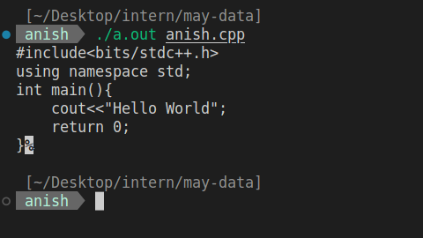
Sample when we execute previous code

Slide 19
Pointer Vulnerabilities
Pointer vulnerabilities are a common type of software vulnerability that can occur in C/C++ programming languages. Pointers are variables that store memory addresses of other variables or data structures, and they allow programs to manipulate memory directly.
However, if pointers are not used properly, they can lead to security vulnerabilities such as buffer overflows, heap overflows, null pointer dereferences, and use-after-free errors.

Slide 20
Null pointer dereferencing
If a pointer is not properly initialized or is set to NULL, it can cause a null pointer dereference error when the program attempts to access memory using the pointer. This can cause the program to crash or exhibit unexpected behavior.
#include <stdio.h>
int main()
{
int *ptr = NULL; // Initialize a pointer to NULL
*ptr = 10; // Dereference a null pointer
printf("Value: %d", *ptr);
return 0;
//cause segmentation fault
}

Slide 21
2. Use after free
When a program frees memory that was previously allocated to an object or data structure, any pointers that still reference that memory become invalid. If the program continues to use these invalid pointers, it can cause a use-after-free vulnerability. Attackers can exploit this vulnerability to manipulate memory and execute arbitrary code.
#include <stdlib.h>
#include <stdio.h>
int main() {
char* ptr = (char*) malloc(10);
free(ptr);
ptr[0] = 'A'; // use-after-free vulnerability
return 0;
}

Slide 22
3. Double free
This can occur when a pointer to the same block of memory is mistakenly passed to free() more than once, or when a pointer to an already freed block of memory is mistakenly passed to free() again. When this happens, the memory management system may become unstable and the program may crash, exhibit unexpected behavior, or be vulnerable to exploitation by attackers.
int main() {
char* ptr = (char*) malloc(10);
free(ptr);
// do some operations on ptr
free(ptr);
return 0;
}

Slide 23
Comparison between assembly code generated by different gcc compilers
#include <stdio.h>
#include <string.h>
int main(void)
{
char buff[15];
int pass = 0;
printf("\n Enter the password : \n");
gets(buff);
if (strcmp(buff, "mansarovar"))
{
printf("\n Wrong Password \n");
}
else
{
printf("\n Correct Password \n");
pass = 1;
}
if (pass)
{
/* Now Give root or admin rights to user*/
printf("\n Root privileges given to the user \n");
}
return 0;
}

Slide 24
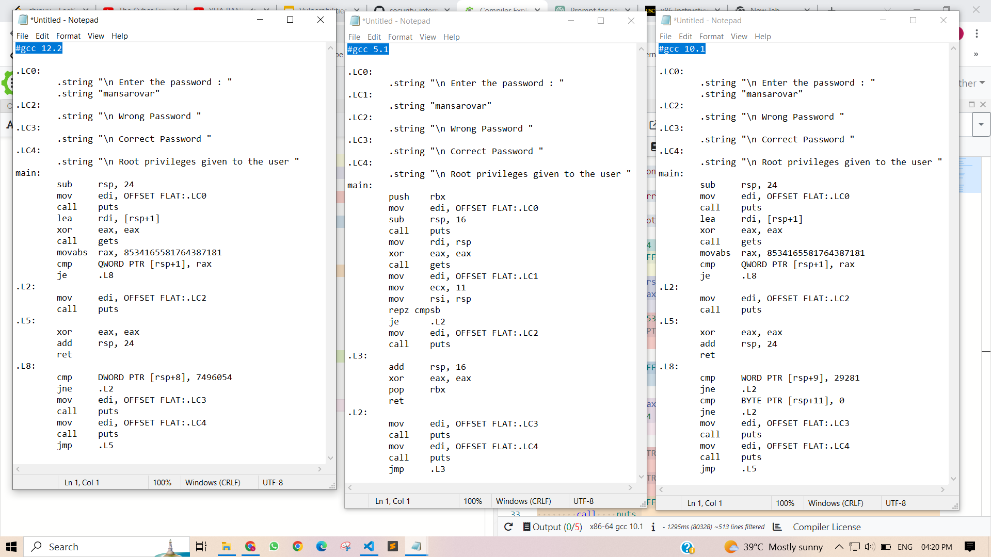

Slide 25
What we observed from this comparison
Differences in function prologue and epilogue:
GCC 12.2 uses the sub rsp, 24 instruction to allocate 24 bytes of stack space in the function prologue, while GCC 5.1 uses sub rsp, 16.
GCC 12.2 uses add rsp, 24 to deallocate stack space in the function epilogue, while GCC 5.1 uses add rsp, 16.
GCC 12.2 saves and restores the value of the rbx register using the push rbx and pop rbx instructions, while GCC 5.1 does not modify the rbx register.
Differences in string comparison:
GCC 12.2 uses the movabs rax, 8534165581764387181 instruction to load the value of the string "mansarovar" into the rax register for comparison, while GCC 5.1 uses the mov edi, OFFSET FLAT:.LC1 and mov rsi, rsp instructions to compare the strings byte by byte using the repz cmpsb instruction.
GCC 12.2 uses cmp QWORD PTR [rsp+1], rax to compare the strings, while GCC 5.1 uses repz cmpsb.

Slide 26
Continue …
The basic structure of the code is the same in all the three versions, indicating that the overall approach taken by the compiler to generate assembly code has remained largely unchanged over these versions.
The assembly code generated by GCC 5.1 has a push and pop instruction that saves and restores the value of RBX register, which is not present in the code generated by GCC 10.1 and 12.2.
The instruction set used by GCC 10.1 and 12.2 is slightly different from GCC 5.1 as they have used the instruction cmp BYTE PTR [rsp+11], 0 instead of cmp DWORD PTR [rsp+8], 7496054 used in GCC 12.2 and mov ecx, 11 and repz cmpsb used in GCC 5.1.

Slide 27
Conclusion
Improved optimization:
For example, GCC 12.2 generates more efficient code for the password check, using a single cmp instruction to compare the entire password string to a precomputed constant value, while GCC 5.1 uses a loop to compare the password byte by byte.
Better code generation for specific architectures:
For example, GCC 10.1 generates code that uses a smaller number of instructions to check the password length, using a single cmp instruction to check the last byte and a separate instruction to check that the byte before the null terminator is zero, while GCC 12.2 uses two separate instructions to check the length.
Newer instruction set support:
For example, GCC 12.2 generates code that uses the movabs instruction to load a 64-bit constant value into a register, which is not available in earlier versions of GCC.
Improved register allocation:
For example, GCC 10.1 uses a different set of registers for some operations, which may result in fewer register spills and better performance.
Improved memory access optimization:
For example, GCC 12.2 uses a different sequence of instructions to access the buffer used to read the password, which may result in better cache behavior and better performance.

Slide 28
Thank You

